Slide 1

Smeal REIT
Stock Pitch Competition
Introductions
Rules
What is a “REIT”?
Resources

Slide 2
Introductions
Brent W. Ambrose
  Smeal Professor and Director, IRES
Lisa Ford
  Associate Director, IRES

Slide 3
The Competition
An opportunity to showcase your ideas in a 3-minute stock pitch format and to test your knowledge of Real Estate.
  Judges: Panel of industry experts
    Diane Wade, CBRE Clarion Securities
    Todd Thomas, Key Banc
    Brad Burke, Goldman Sachs
  Format: 3-minute presentation with 10-minutes of Q&A with judges

Slide 4
The Rules & Key Dates
Thursday, January 23, 2020 by 4:00pm
  Students wishing to participate must register and commit by this date
  Applications will be due by e-mail or in the IRES Office (333A Business Building) by 4:00pm to the attention of Lisa Ford (lef7@psu.edu)
Tuesday, January 28, 2020
  All students notified with directions for uploading their competition materials

Slide 5
Preliminary Round
Thursday, February 6 by 4:00pm
  Handouts and video clip must be uploaded to the BOX site. Only those participants with complete documents will be considered for the preliminary round.
  Participants must prepare a written research report outlining their investment idea. The maximum length is 3 pages for a written report.

Slide 6
Preliminary Round
  Participants have the option to create a PowerPoint presentation outlining their investment idea. (Optional and not required)
  Participants will need to record a video of themselves presenting their stock pitch. The video needs to be at least 1 minute in length but not more than 3 minutes in length.
  The report, video and optional PowerPoint presentation must be uploaded to the BOX site.
  Participants will be judged based on the pitch idea and video presentation.

Slide 7
Preliminary Round
Thursday, February 13 by 5:00pm
  Competition Judges (Real Estate faculty and Wall Street professionals) will select finalists for the competition.
  All preliminary round participants will receive notification by e-mail regarding their status. For the finalists, a BOX link will be provided with directions for uploading competition materials for the semi-final round.

Slide 8
Semi-Final Round
Monday, February 24, 2020 by 4:00pm
  Finalists have the option to revise their mandatory written report and optional PowerPoint presentation.
  The written report and optional PowerPoint presentation must be uploaded to the BOX site. Only those participants with complete documents will be considered for the final round.

Slide 9
Semi-Final Round
Wednesday, February 26, 2020
  Participants will each be assigned a presentation time. Each participant will have 2 minutes to set-up for their stock pitch (this includes but is not limited to setting up and running their power-point presentation, and organizing their handouts).
  Each student will have 3 minutes to present their REIT investment idea. The presentation will be timed and the student will be stopped at 3 minutes.
  Judges will not ask questions during the 3 minute presentation. Judges will have no more than 10 minutes total to ask questions at the conclusion of each presentation and receive answers.

Slide 10
Final Round
Friday, March 27, 2020
  Four finalists will travel to the World Trade Center in New York City to present to a panel of industry experts and the IRES Advisory Board.
  Each student will have 3 minutes to present their REIT investment idea. The presentation will be timed and the student will be stopped at 3 minutes.
  Judges will not ask questions during the 3 minute presentation. Judges will have no more than 10 minutes total to ask questions at the conclusion of each presentation and receive answers.
  Winners will be announced at the IRES Networking event that evening.

Slide 11
What is a REIT?
Securitized real estate investment
Ownership form created by tax code
Basic requirements:
  Be Real Estate
  Pass-through income to shareholders
    High dividends / low retained earnings
  Avoids corporate tax

Slide 12
General Structure of
Real Estate Investment Trusts (REITs)
Primary( Direct) Real Estate Capital Market
Secondary (Indirect) Real Estate Capital Market
Sale Proceeds from
IPO subscription used
to purchase property
Capital Market Investors
Subscribed in IPO allowing
REIT to raise capital
Property Owner/Seller
Income Producing
Real Estate
REIT
(Trust)
Investors
(Purchase Shares)
Rental Cash Flow
Dividend income/
Capital gains
Owner/Seller of Property
Sponsors REIT

Slide 13
Key Requirements of REITs
Asset Test:
  At least 75% of a REIT’s asset value must come from real estate, cash, and government securities at the close of each quarter of taxable year
  No more than 5% of the value of the assets may consist of the securities of one issuer, and REIT may not own more than 10% of the outstanding shares of one issuer, if those securities are not includable in the 75% test
Income Test:
  At least 95% of gross income must come from dividends, interests, rents, or gains from sale of certain assets
  No more than 30% of REITs gross income can be derived from sale of real estate held for less than four years or securities held for less than six months
Distribution Test:
  At least 90% of the REIT taxable income must be distributed to shareholders
Stock and Ownership Test:
  REIT shares must be transferable and must be held by a minimum of 100 persons
  No more than 50% of REIT shares may be held by five or fewer persons

Slide 14
REIT Types
Equity
  Most common
  Invest directly in real property
  Uses debt to finance acquisitions
Mortgage
  Invest in real estate debt
  Uses debt to finance acquisitions
Hybrid
  Take position in equity and debt

Slide 15
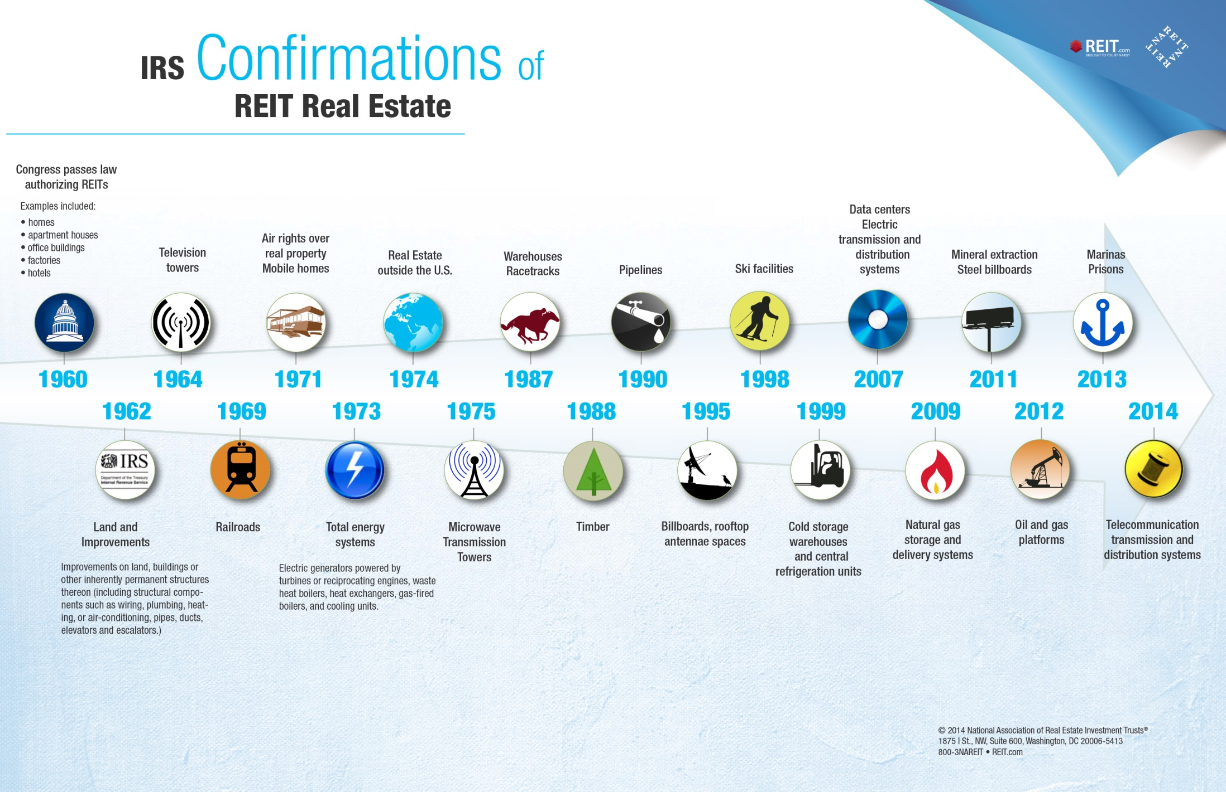
Assets Confirmed as “Real Estate” under REIT Rules

Slide 16
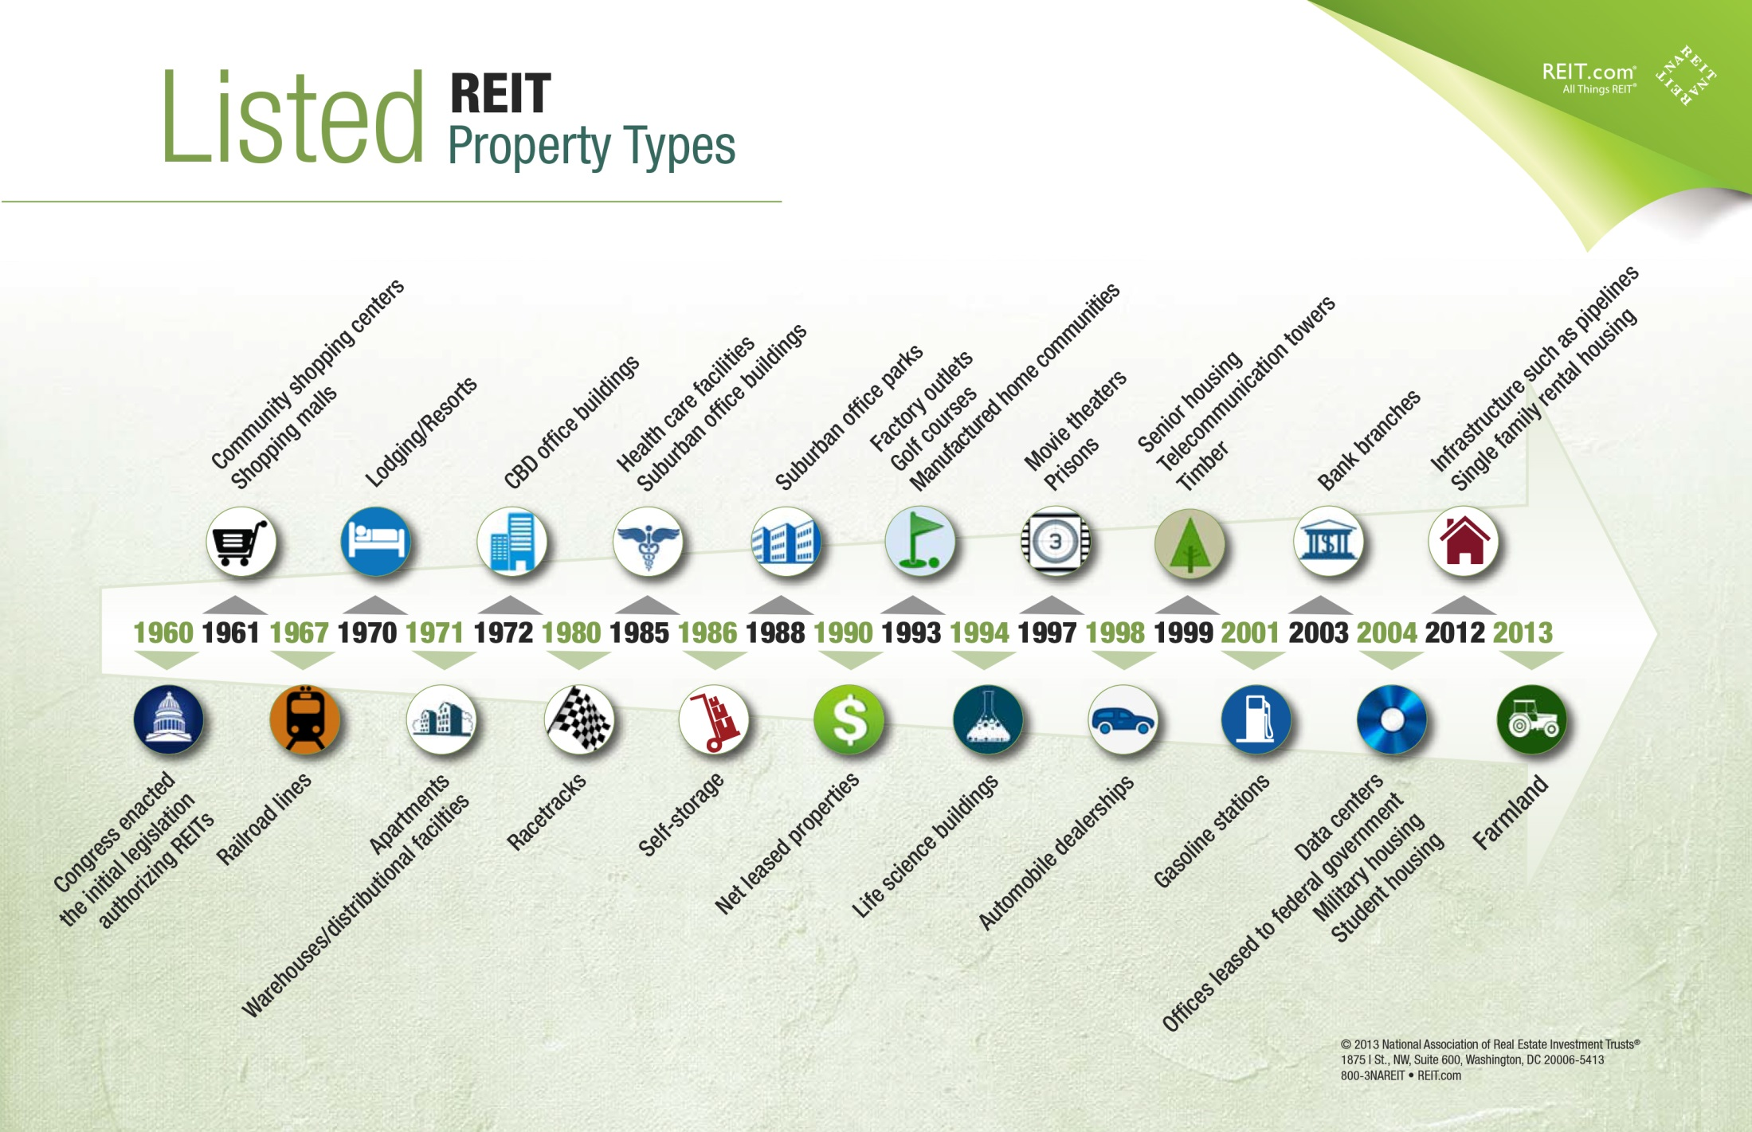
Assets Actually Available through Listed Equity REITs

Slide 17
Listed REIT Equity Market Capitalization
2007: Equity Office
Properties LBO
1992: Taubman Centers IPO
(First UPREIT)
1993: Relaxation of the “Five or Fewer” Rule for Pension Funds
1991: Kimco IPO
Modern REIT Era Begins
1989: Collapse of Real Estate Market
1986: Tax Reform Act Permits Internal Management
1960s-1970s: Mortgage and Hybrid REITs Dominant
2007-2009: Great Financial Crisis
Note: Monthly data as of November 2014.

Slide 18
Listed Domestic Equity REIT Industry
Broad Diversification by Property Type and Geography
Property Sector | Percent
Regional Malls Residential Health Care Office Buildings Diversified Infrastructure Shopping Centers Lodging/Resorts Self-Storage Free Standing Retail Timber Industrial Facilities Mixed Industrial/Office | 13 13 11 10 9 9 8 7 5 4 4 4 2
Total | 100
U.S. listed equity REITs currently hold
more than 40,000 properties in this country
Data as of September 30, 2014
Source: NAREIT®

Slide 19
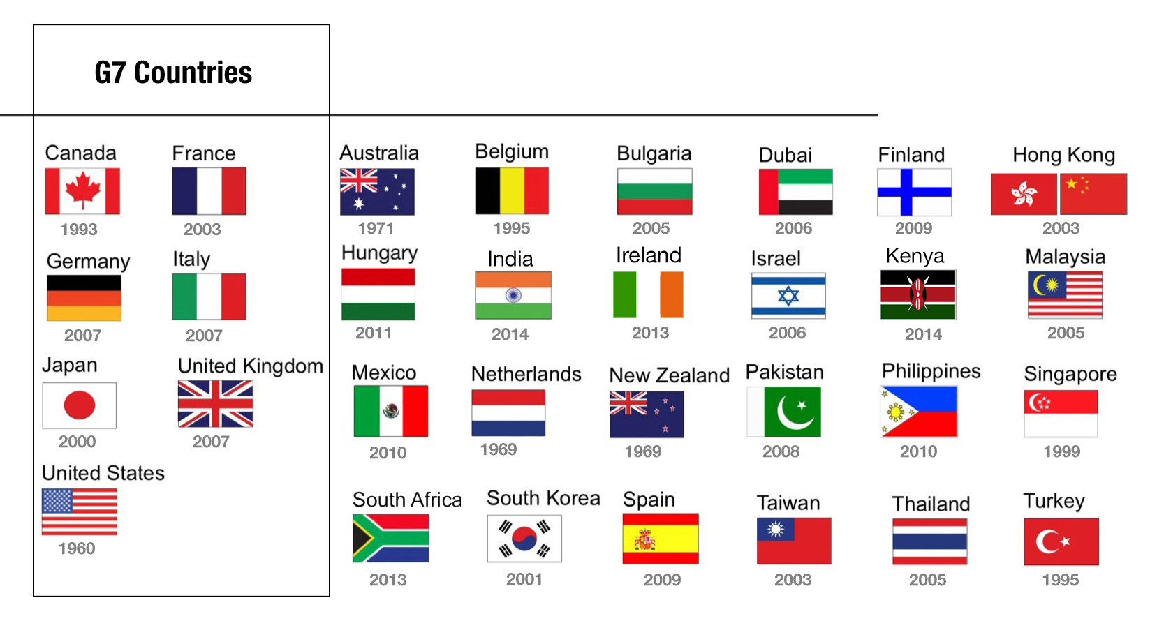
Global Expansion of the REIT Business Model
Data as of August 10, 2014.

Slide 20
REIT Data Resources
NAREIT: www.reit.com
SNL: www.snl.com
NCREIF: www.ncreif.org
CoStar: www.costar.com
RCA: www.rcanalytics.com

Slide 21
Resources
How to give a stock pitch:
  Steve Bisbee: https://vimeo.com/260461988/6e80a61d86
  What is a REIT?
    https://www.reit.com/what-reit
    https://www.reit.com/what-reit/reit-basics
    https://www.reit.com/investing/how-invest-reits

